Slide 1
Developing your research pitch
Program:
Date:
Notes:
Script for the facilitator: What is a research pitch: A Research pitch is a brief, informative, and compelling story of who you are as a researcher. By your research pitch you will be able to maximize your connection with your audience without using presentation tools such as ppt, slides, papers, … in a minimal amount of time.

Slide 2
Workshop learning objectives
Create curiosity in your audience to develop interest in your research.
Create and practice various pitches for professional and novice audiences.
Capitalize on opportunities.
Create a lasting connection with the audience.
Notes:
Building lasting connection
Inform the audience
Help them with the value you create
Relate to your audience
How can we INFORM our audience?
Who you are professionally
Where you have been
Where you are going
How can we HELP our audience?
Look for opportunities to help them
A material that can be useful to them
A person or professional organization that might be helpful
Beyond informing them about who you are, you're trying to add value when attempting to connect with someone
How can we RELATE to the audience?
Shared interests
Shared personal or professional experiences
Finding one or two things that you both share makes you more relatable and memorable.
the goal of using the pitch and trying to make connection with someone. It's not about you trying to gain some benefit now.

Slide 3
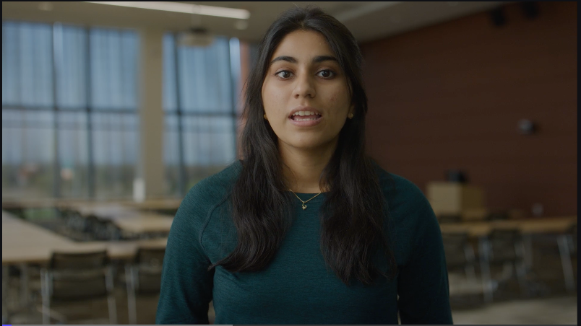
Let’s watch this video together!
Notes:
Watch the video
[5 min]

Slide 4
Who are the main STAKEHOLDERS (audiences) for your research ?
Notes:
Expert in your field:
A PI you are meeting for a job interview
A PI you meet in a networking event
Another student in another lab
An engineer from a tech company
A potential sponsor
An officer or program director from a foundation
A person without the background:
A professional from another field (such as finance, accounting, etc)
A young high school student interested in research
A friend or family member

Slide 5
What is the main NEED for your research?
Notes:
Activity 1: Before watching the video ask students to answer this question in ~5 words or less. Give students 1-2 mins.

Slide 6
What is the main VALUE that you create in your research?
Notes:
Activity 1: Before watching the video ask students to answer this question. Give students 1-2 mins.

Slide 7
To be successful, you’ll want to have different types of pitches ready.
Networking environment: 1 min pitch without slides
Technical pitch to show data: 3 min pitch with 1 slide
Recorded pitches
Notes:
Highlight that there are 3 types
[2-3 min]

Slide 8
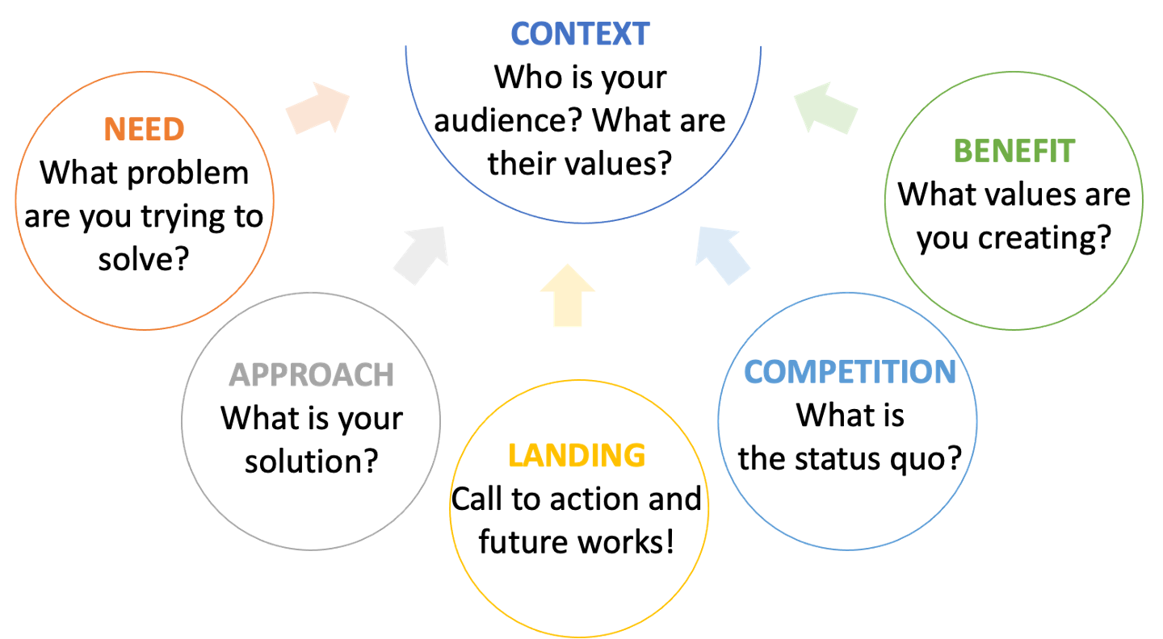
Notes:
Framework of a great pitch is specified here.
It is important to know who is our audience, what are their values, in which environment you are communicating with them. These are the parameters that specify the Context.
Then describe need and benefit
(Benefit is higher level than solution; solution is the technological solution)
Then describe the solution
Then describe the competition
Then bring it in from a landing

Slide 9
Activity 2: Create components of a pitch!
Need: What is the problem your research is trying to solve?
Benefit: Why your work is significant? What is the value you created? Who or what will benefit from the result? How these results can be used to a larger impact in the future?
Approach:What is your solution? How is my research contributing to the solution? What are my expected results?
Competition:What is the existing situation?
Landing: Where are you going? What can the audience do now?
Notes:
Answer the following questions for two types of audiences an expert in your field, a person who does not have the background information about the specific topic.
We don’t want to have all parts of a research article, paper, or book. They are good on their own, but they are different from a research pitch. They are good for written format, but the pitch is about here and now. And conveying things in an active matter.
Need
Approach
Benefit
Competition
Action
1- For each question you have 1 min to answer as many question as possible.
People make a mistake of starting with How (messy details), but you should start with Why you are doing your research. You don't want to repeat your research question. Put your research in a broader context. What part of the problem your research is focusing on. Explain the problem to catch people’s attention.
2- Tell us what is your approach and what is making it especial. Dont explain the exact method here. If the methods are not part of the uniqueness of the project, just leave them out. Results you got, or expect to get in your research. Are there any breakthroughs. We want to know what your research will/would lead to.
3- Why your work is significant? What is the value you created? Who or what will benefit from the result? How these results can be used to a larger impact in the future?
4- Finish your pitch with call to an action. Because pitch is a start a conversation.

Slide 10
Preparation will optimize your pitch delivery.
Write a script using the framework
Allow for pauses to make the script feel more natural
Seek feedback by practicing with a partner
Update your script based on the feedback you get
Practice with a timer
Seek feedback from researchers or people outside your field
Ask a partner to retell your pitch to see how they understand your work

Slide 11
Activity 3: Networking short pitch with no slide
The purpose of your short pitch is to create a lasting connection for future interactions.
Prepare a concise pitch (30-60 sec). A typical 1 min pitch is around 150 words.
Include the five components of a pitch in plain language; avoid jargon.
Your attitude should be confident, but not arrogant.
You should land your pitch by asking about your audience’s work/interests and never ask for anything.
Notes:
In the short pitch (30 - 60 s), would there be time to ask about someone else's work? Should the students just focus on their pitch for the activity, but keep in mind this would be a follow-up in networking?
Research is complex, but don’t be confusing

Slide 12
Activity 4: 3-minute pitch with 1 slide
(Connection) Create a connection to your audience by relating to them: Start with a personal story or experience, relevant news, relevant areas.
(Curiosity) Keep them interested: Make your audience wonder and curious to hear more. Instead of linear order, use a question/answer dynamic throughout the pitch.
Send your audience home with a take-home message or an open-ended question to start a conversation.
Don’t dive into complex details.
Convey why your research matters to them, so they can remember your work.
Notes:
Don’t dive into complex materials right at the beginning of your 3 min pitch, you will confuse the the audience and lose their attention. You want to guide your audience not drag them. You want to make connection with your audience.
Audience: professional in your field of study

Slide 13
Asynchronous Activity: Create recordings of your two pitches!
Pro tips can help you create a distinctive recorded pitch.
People want to see you: be centered and close to your camera.
Adjust the lighting to be on your face.
Use a neutral background.
Use a good mic; use a separate mic if necessary.
Notes:
Appendix: in case you want to ask your students to record their pitch. Short networking one or extended technical one.
Repeat activity 3 if not using a slide – insight: people want to communicate with you not the slides
Repeat activity 4 if using a slide

