Slide 1
Lecture 3
Introduction to Overarching Problems

Slide 2
Overarching Problems
Civil Engineering Infrastructure Project
Structures
Water Resources
Environmental
Geotechnical
Construction
Materials
Transportation
Through the rest of the course, we will deal with three classic civil engineering problems.
These complex design problems will be referred to as overarching problems because they are broad in nature and bring together many of the fundamental mechanics concepts that we will learn in this class.
These problems will serve to:
provide context of how mechanics concepts are used in civil engineering
show how different mechanics concepts relate to each other
show how complex problems can be broken up into a series of smaller fundamental steps
Overarching Problem
Mechanics Concept
Mechanics Concept
Mechanics Concept
Mechanics Concept
Mechanics Concept

Slide 3
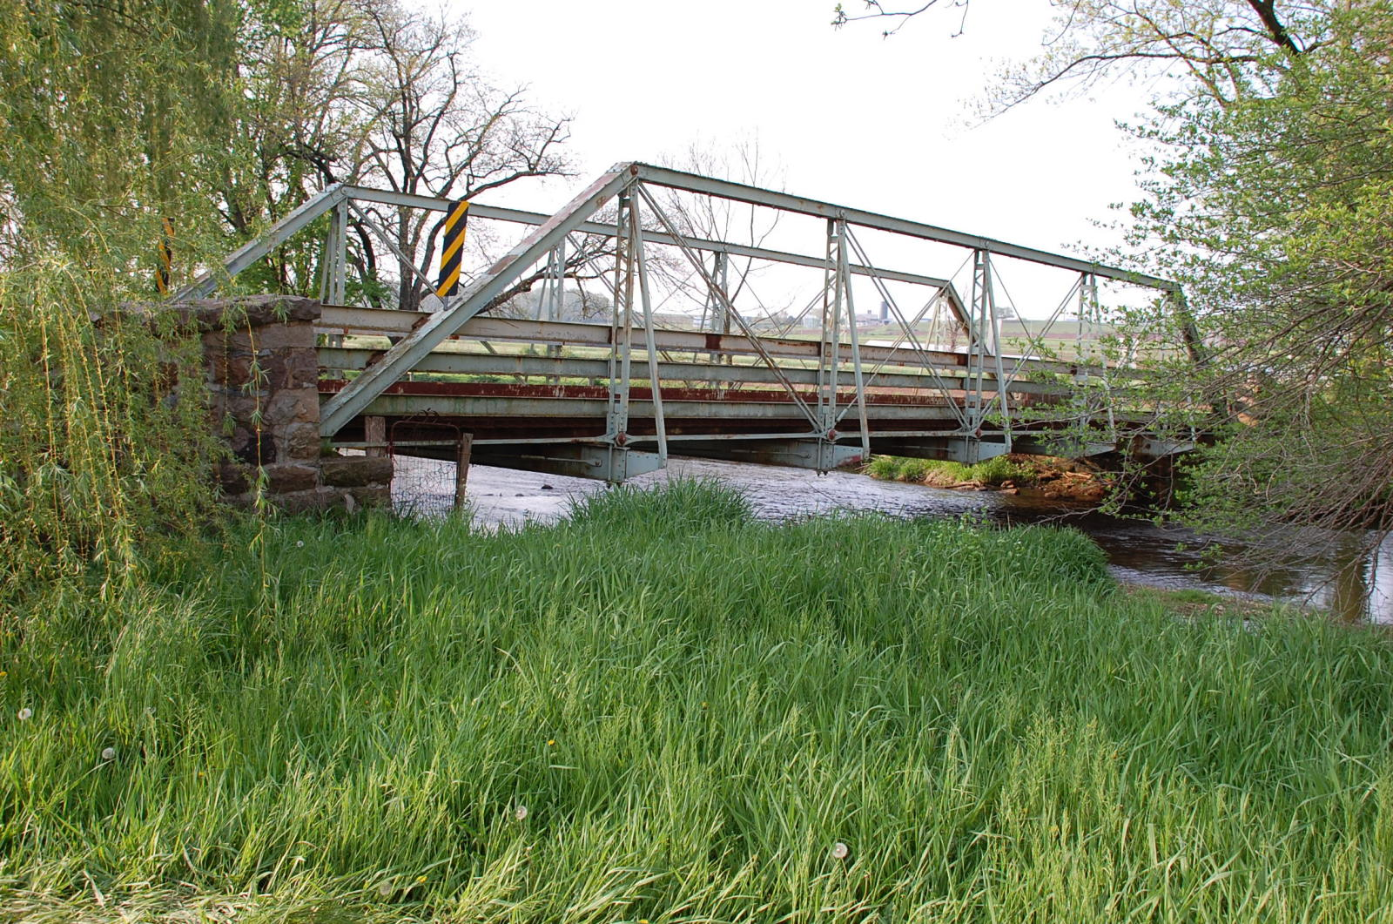
Overarching Problem #1
Steel Truss Bridge

Slide 4
Overarching Problem #1
Steel Truss Bridge
Our first overarching problem will involve a steel truss bridge
The design of this bridge may involve several subdisciplines of civil engineering.
Civil Engineering Infrastructure Project
Materials
Water Resources
Environmental
Construction
Transportation
Structures
Geotechnical

Slide 5
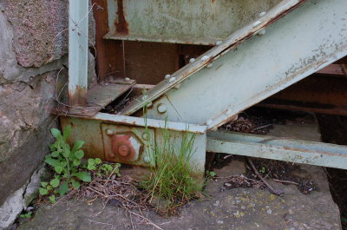
Overarching Problem #1
Steel Truss Bridge
What is the magnitude of the support reaction?

Slide 6
Overarching Problem #1
Steel Truss Bridge
Several fundamental mechanics concepts that we cover in this class will relate to the design of this bridge.
Design of Steel Truss Bridge
Factor of Safety
(Lect. 7)
Simple Connections
(Lect. 15)
Stress-Strain Relationships
(Lect. 16-19)
Truss Analysis
(Lect. 11-12, 14)
Normal & Shear Stress
(Lect. 13)
Axial Deformations
(Lect. 20,22-24)
Material Properties of Steel
(Lect. 18, 21)
Particle Equilibrium
(Lect. 6-7)
Rigid Body Equilibrium
(Lect. 8-10)

Slide 7
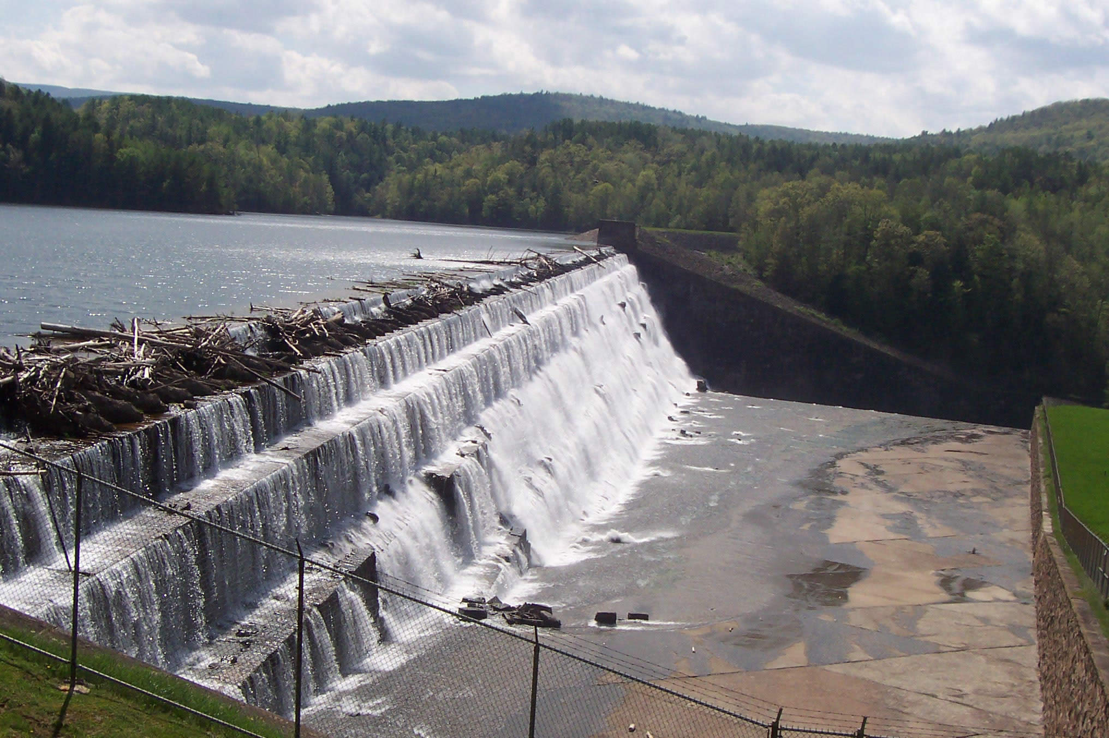
Overarching Problem #2
Gravity Dam
Notes:
7

Slide 8
Overarching Problem #2
Gravity Dam
Several fundamental mechanics concepts that we cover in this class will relate to the design of this dam.
Design of Gravity Dam
Factor of Safety
(Lect. 7)
Simple Distributed Force Patterns
(Lect. 33)
Dry Friction/ Impending Motion
(Lect. 28 – 30)
Generalized Distributed Loading/Fluid Pressure
(Lect. 36)
Centroid of Composite Areas
(Lect. 37, 38)
Moment of a Force
(Lect. 4-5)
Rigid Body Equilibrium
(Lect. 8-10)
Notes:
8

Slide 9
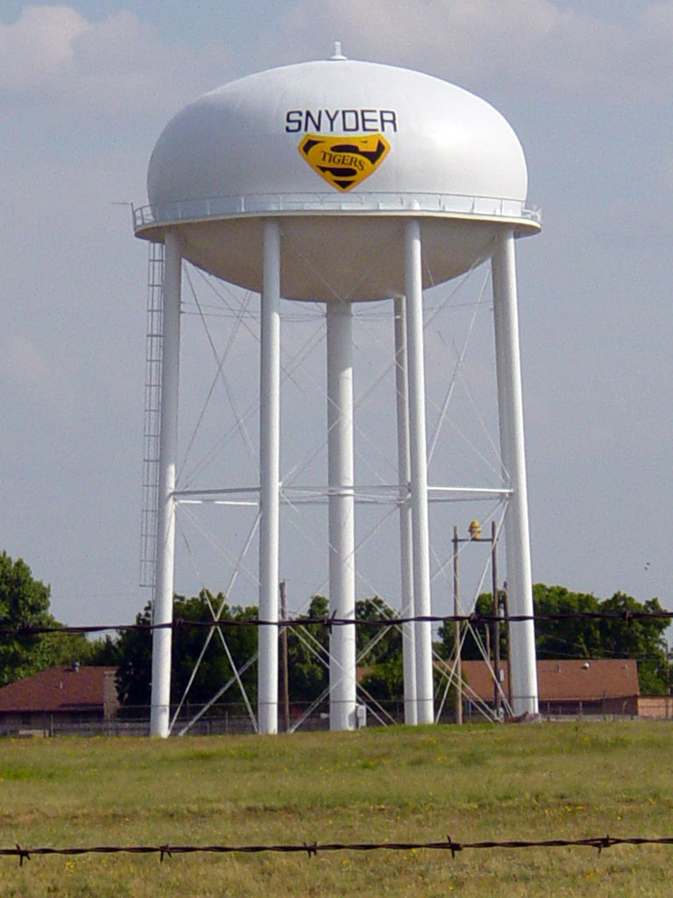
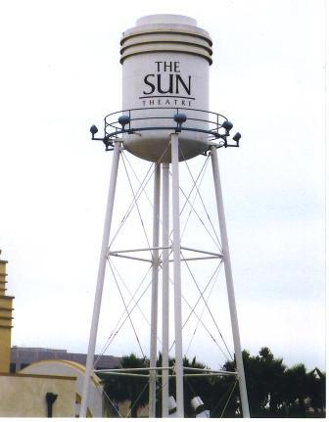
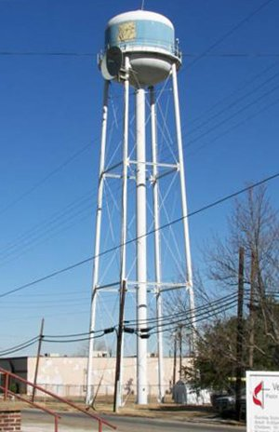
Overarching Problem #3
Water Tower
Notes:
9

Slide 10
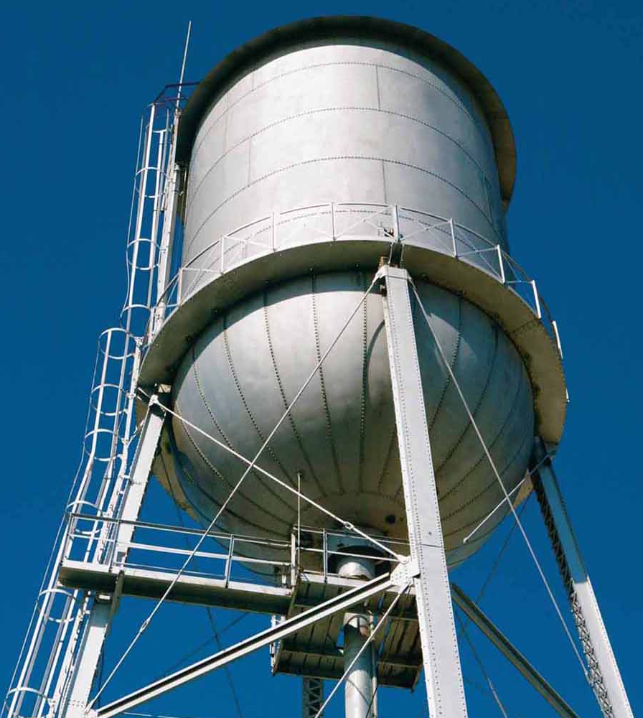
Overarching Problem #3
Water Tower
Several fundamental mechanics concepts that we cover in this class will relate to the design of a water tower.
Design of a Water Tower
Rigid Body Equilibrium
(Lect. 8-10)
Moments of Inertia , Parallel Axis Theorem
(Lect. 39,41-43)
Buckling of Columns
(Lect. 44-45)
Centroids
(Lect. 34-38)
Generalized Distributed Load, Fluid Pressure
(Lect. 36)
Slenderness Ratio and End Effects
(Lect. 46)
Factor of Safety (Lect. 7)
Tension Testing (Lect. 17-18)
Equivalent Force Systems
(Lect. 31-32)
Notes:
10

Slide 11
CATME Results
Announcement of teams
Sit with your team and introduce yourselves

Slide 12
Water Towers
Why do we need them?
How do they work?
Deliverable (due in 30 min.):
A single slide PowerPoint presentation that your team will deliver in no more than two minutes answering the above questions

Slide 13
KEEN: The Kern Entrepreneurial Engineering Network

Slide 14
The Three C’s

