Slide 1
Nzulezu
Water Tower
A Project By: Ed Keenan, Ben Moore, Bridget Moore, Allison Olsonoski

Slide 2
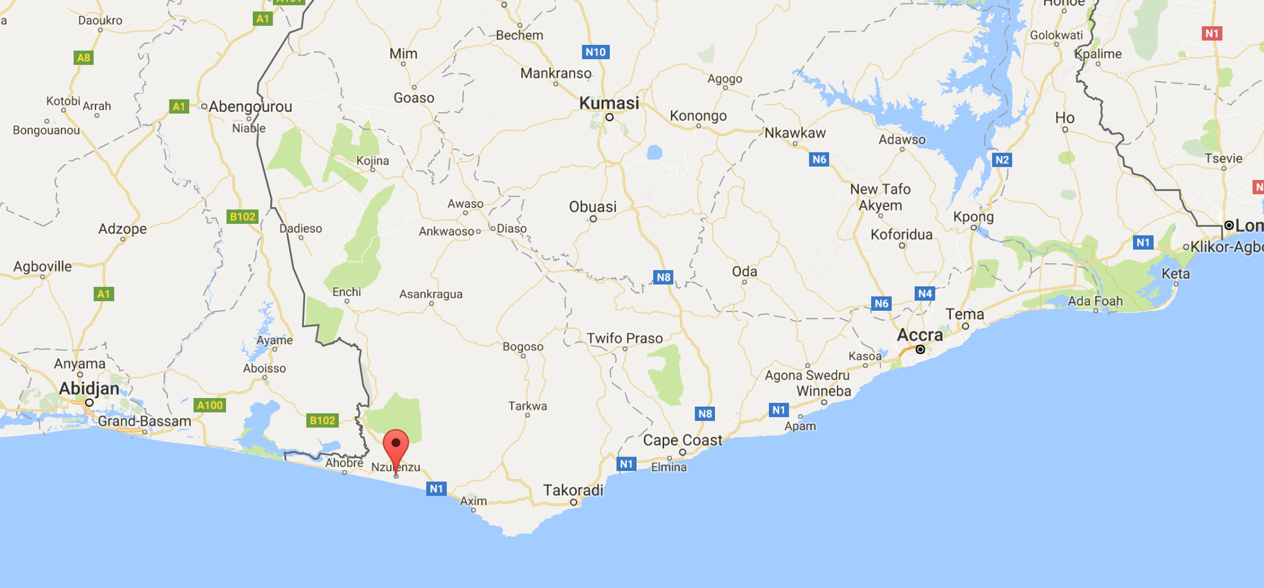
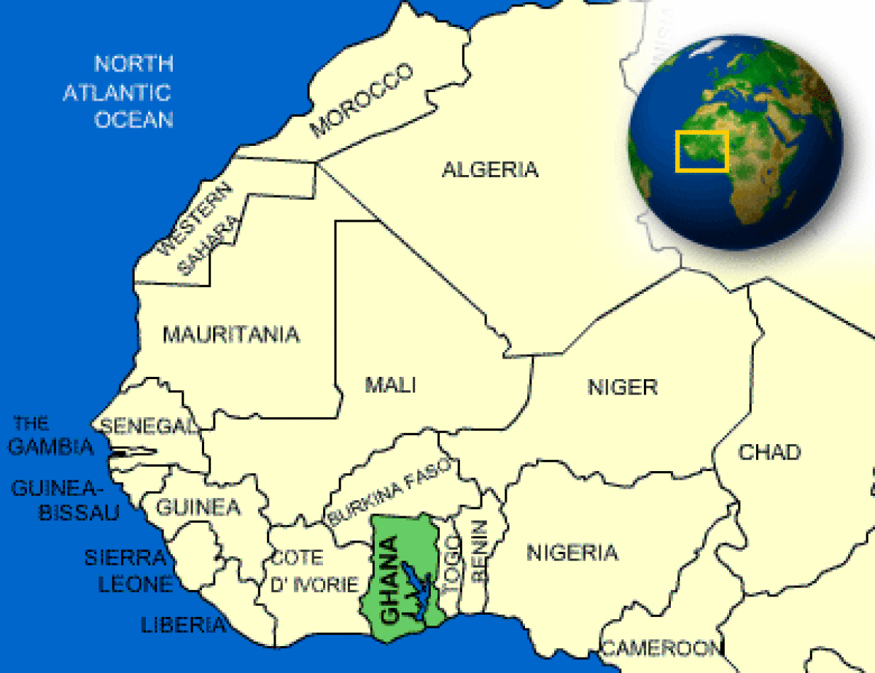
Nzulezu, Ghana

Slide 3
Nzulezu, Ghana

Slide 4
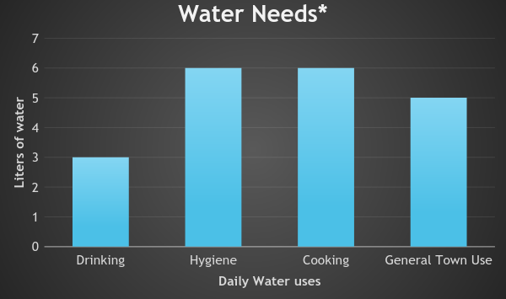
Water Needs in Nzulezu
*Numbers from 2013 WHO Report on Water Requirements

Slide 5
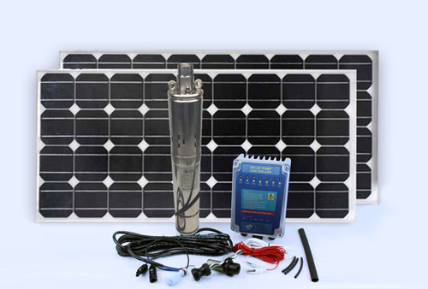
Pump System

Slide 6
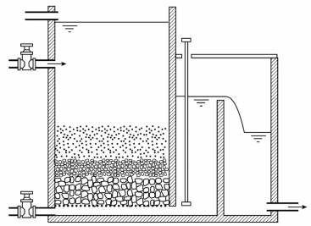
Filtration

Slide 7
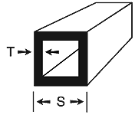
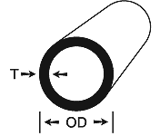
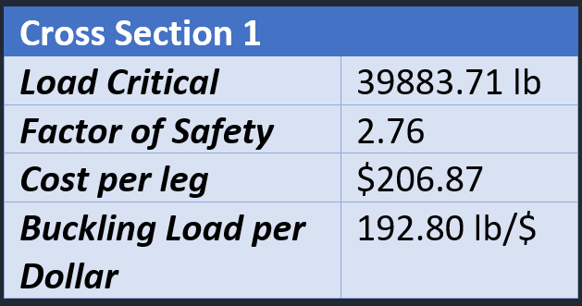
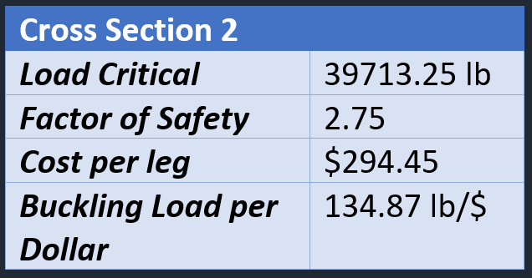
Water Tower
T = 0.1875 in , S = 2.5 in
T = 0.25 in , OD = 2.75 in

Slide 8
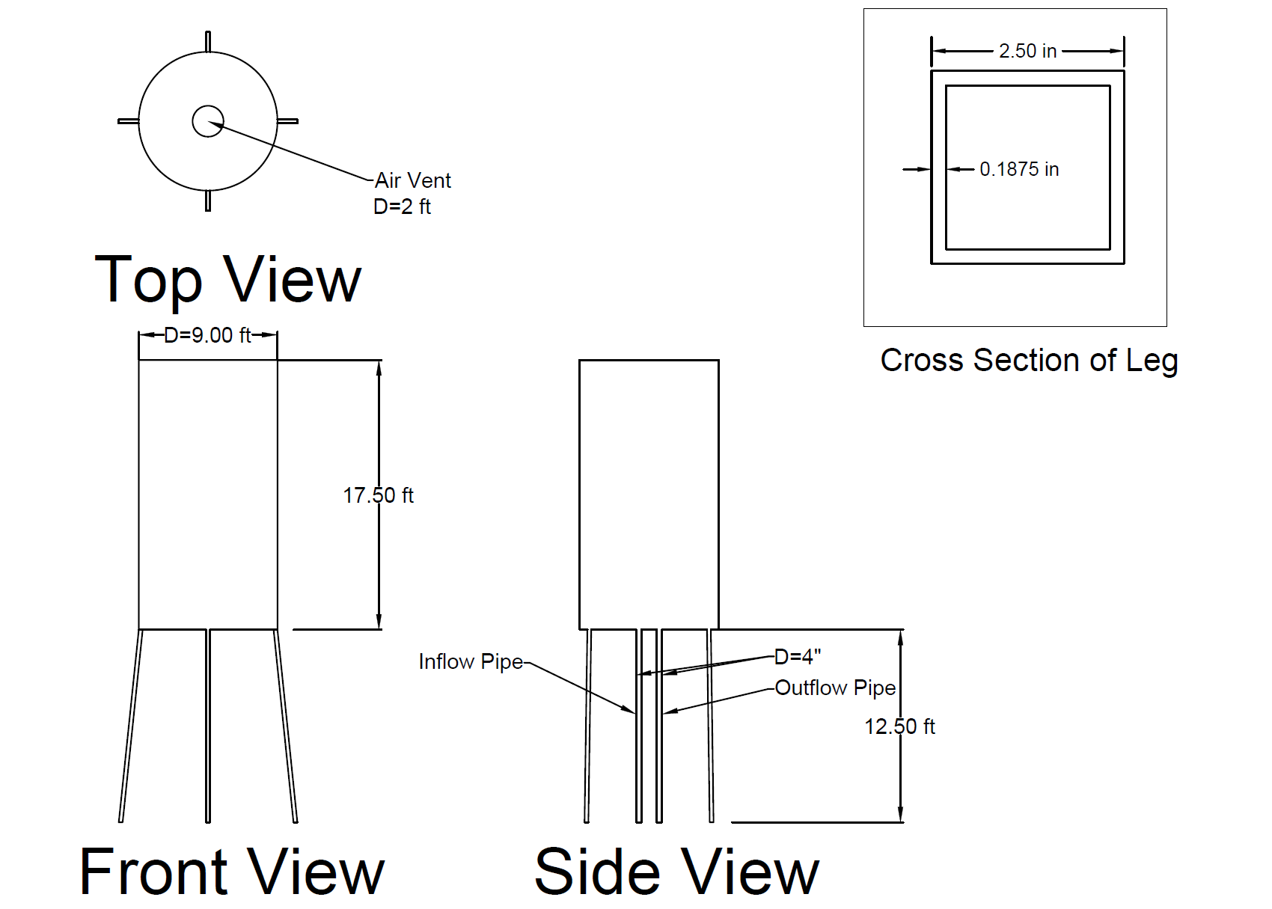
Water Tower

Slide 9
Material Costs
Tower:
Pipe System:
Home Faucets:

Slide 10
Material Costs
Filter System:
Pump System:
TOTAL MATERIALS COST: $13,922

Slide 11
Construction & Maintenance Plan
Bring small construction team (12 people) for the project
Concrete made on sight, all other materials transported by boat
Work with the town while building the tower
Teach them how to fix and build tower in case tower needs repair
Train a small team of about 4 local villagers how to run tower without our team there
Teach them how to quantify water use per person using water meters
Explain how often tower should be checked and how to replace parts if necessary
Teach them how to operate and properly clean sand filter
Teach them how to operate solar power / battery backup system

Slide 12
Funding
Materials Transportation and Construction
Foundation *Water.org
*Safe Water Network
UNESCO
Catholic Relief Services
United States Agency for International
Development (USAID)
*Organizations that does water supply work in Ghana

Slide 13
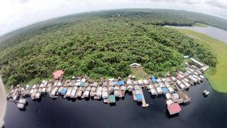
Conclusion
We are asking the Foundation for $14,000 to cover the cost of materials to build a water tower and distribution system within Nzulezu, Ghana.

Slide 14
Sources
http://sungparkmultimedia.com/new-blog/2014/3/8/nzulezu-stilt-village
ttp://www.sswm.info/category/implementation-tools/water-purification/hardware/semi-centralised-drinking-water-treatmen-2
http://www.windmill-parts.com/id14.html
https://www.homedepot.com/p/4-in-x-10-ft-PVC-Sch-40-DWV-Plain-End-Pipe-531103/100156409
https://www.homedepot.com/p/2-in-x-10-ft-280-PSI-Schedule-40-PVC-DWV-Plain-End-Pipe-531137/100161954
https://www.homedepot.com/p/DURA-4-in-Schedule-40-PVC-Extra-Deep-Coupling-SxS-479-040/203217869?cm_mmc=Shopping%7cTHD%7cG%7c0%7cG-BASE-PLA-D26P-Plumbing%7c&gclid=EAIaIQobChMI_PfVj5-e1wIVhrvtCh2gtAEOEAQYASABEgIAIPD_BwE&gclsrc=aw.ds&dclid=CMTZwZGfntcCFYuWyAod2OUAXg
https://www.homedepot.com/p/Charlotte-Pipe-2-in-PVC-Sch-40-S-x-S-Coupling-PVC021001600HD/203811391
http://www.qvc.com/P3-P0550-Water-Meter.product.H364048.html?colorId=000&sizeId=000&ref=GAS&cm_mmc=GOOGLESHOPPINGFEED-_-GShopping|M|Generic|home+improvement-_-pla-_-sU64uwjhU|dc_307261086871__H364048-000-000_&mkwid=sU64uwjhU|dc_pcrid_307261086871_pkw__pmt__productid_H364048-000-000&TZ=EST
https://www.irena.org/DocumentDownloads/Publications/IRENA_Solar_PV_Costs_Africa_2016.pdf
https://www.rpssolarpumps.com/shop/rps-1-3-50-pump-kit/
https://www.amazon.com/dp/B00AAZJ9Y8/ref=twister_B016XAKTQA?_encoding=UTF8&psc=1
https://www.amazon.com/dp/B00PFGP0EA/ref=asc_df_B00PFGP0EA5244372/?tag=hyprod-20&creative=395033&creativeASIN=B00PFGP0EA&linkCode=df0&hvadid=198068984819&hvpos=1o5&hvnetw=g&hvrand=4620685195067866253&hvpone=&hvptwo=&hvqmt=&hvdev=c&hvdvcmdl=&hvlocint=&hvlocphy=9007222&hvtargid=pla-318232543346
http://www.onlinemetals.com/merchant.cfm?pid=12977&step=4&showunits=inches&id=283&top_cat=0
https://www.onlinemetals.com/merchant.cfm?pid=10354&step=4&showunits=inches&id=845&top_cat=849

