Slide 1
Nicaragua
Sustainable Water Systems
Margaret Liedtka, Blaire Miran, Noah Sasse, John Seal

Slide 2
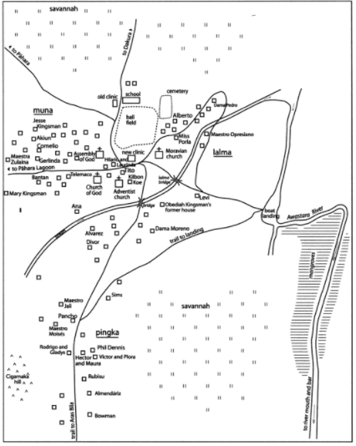
Background
Awastara, Nicaragua
Population: ~500
Indigenous Miskito people
Subsistence agriculture
Dry season, limited rain for 6 months

Slide 3
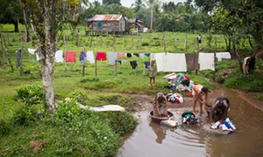
Requirements
10,000 gallons of water for a 24-hour period
2,500 gallons for domestic use
Washing, cooking, etc.
7,500 gallons for agricultural use
Livestock and gardens

Slide 4
Solutions
Groundwater source
Submersible electric water pump
Polyethylene tank
Steel structure, concrete foundation
Delivery via fetching systems

Slide 5
Structural Design

Slide 6
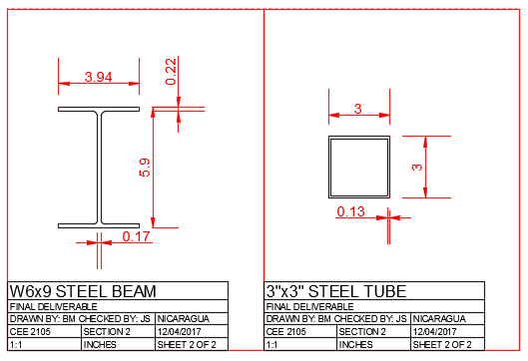
OPTION A
OPTION B
Cross Sectional Views
Please reference page 2 in packet.

Slide 7
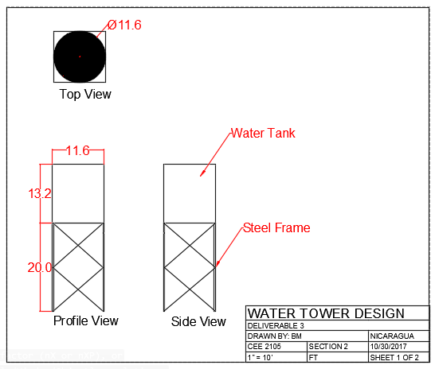
Orthographic View
Please reference page 3 in packet.

Slide 8
Water Distribution System

Slide 9
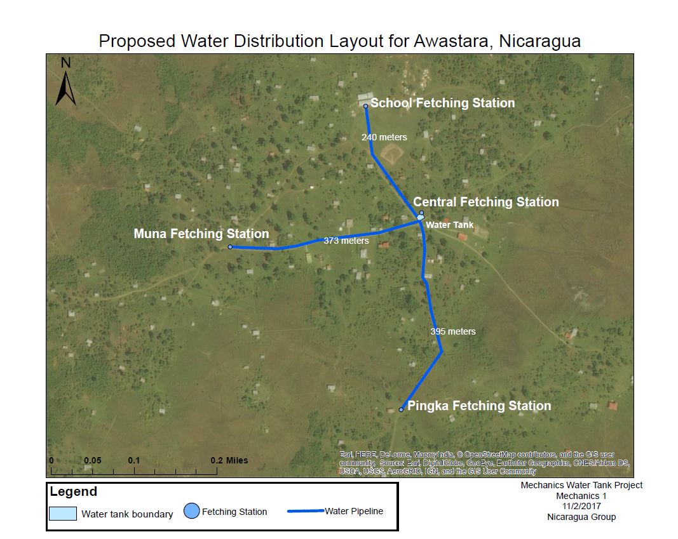
2
3
1
4
Please reference page 4 in packet.

Slide 10
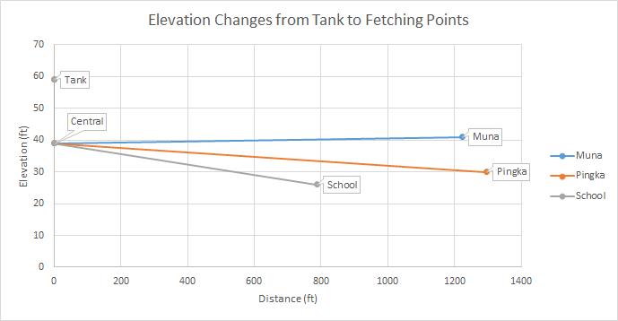
Elevations and Water Pressure
Pressure at Fetching Points:
Central: 8.66 psi
Muna: 7.75 psi
Pingka: 12.51 psi
School: 14.25 psi
Please reference page 5 in packet.
Notes:
Most of the differences in pressure are a result of elevation differences, not horizontal distances

Slide 11
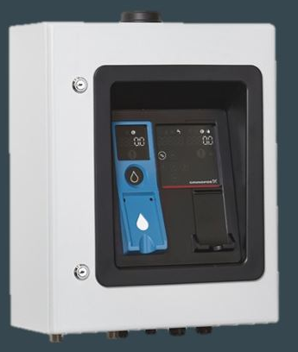
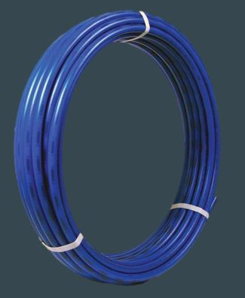
Water Distribution Specifications
Four fetching stations
WaterCard kiosks
1008 meters of underground PEX piping
1 inch diameter

Slide 12
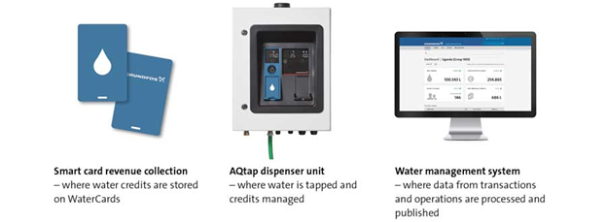
Operation
Grundfos AQtap

Slide 13
Operation and Maintenance Budget
Revenue:
$0.03 per gallon of water dispensed ($300 per tank)
Costs:
Electricity from grid = $0.001 per gallon ($10 per tank)
Powers the submersible pump and ATM dispenser
Based off $0.137/kWh electricity grid tariff
Profit saved for routine maintenance and breakdowns
Accumulated profit each year is redistributed to town
Please reference page 7 in packet.

Slide 14
Final Construction Budget

Slide 15
Final Construction Budget
Please reference page 6 in packet.
 | Amount |  | Unit Cost (USD) |  | Total Cost (USD)
Steel Material | 1.2 | tons | $4,800 | per ton | $5,760
Foundation | 144 | sq ft | $25.00 | per sq ft | $3,600
Submersible Pump | 1 | pump | $600.00 | per pump | $600
Poly Tank | 1 | tank | $5,700 | per tank | $5,700
PEX Pipe | 3400 | ft | $0.80 | per foot | $2,720
Pipe Installation | 40 | man-days | $15.00 | per md | $600
Steel Installation | 50 | man-days | $15.00 | per md | $750
Shipping | Allowance |  | $3,000 |  | $3,000
Water Mgmt System | Allowance |  | $3,000 |  | $3,000
 |  |  | Total: |  | $25,730

Slide 16
$25,730
Specific Monetary Amount
Please reference page 7 in packet.

Slide 17
Alternative Funding Sources
Please reference page 7 in packet.

Slide 18
Nicaragua
Sustainable Water Systems
Thank you for your time and consideration.

Slide 19
Sources
https://en.wikipedia.org/wiki/Electricity_sector_in_Nicaragua#cite_ref-CEPAL07_1-0
https://www.engineeringtoolbox.com/american-wide-flange-steel-beams-d_1319.html
http://67.237.145.72/PDFs/SECTIONPROPERTIES.pdf
https://water.org/our-impact/water-crisis/
Dennis, Philip Adams. The Miskitu People of Awastara. Univ. of Texas Press, 2004.
https://goo.gl/maps/xKyvjLTsHwR2
http://ucanr.edu/sites/scmg/files/185639.pdf
http://www.grundfos.com/products/find-product/aqtap.html

Slide 20
Index
Background
Requirements
Solutions
Orthographic View
Cross Sectional Views
Water Distribution System (Map)
Water Pressure
Operation System
Final Construction Budget
Specific Monetary Amount
Operations and Maintenance Budget
Alternative Funding Sources
Sources
Design Considerations and Process

Slide 21
Design Considerations and Process
Calculations:
1. Find F_{max}
Design:
2. Using factor of safety, calculate F_{allowable}
Find corner support cross section to satisfy I_{min}
Considerations:
Hurricane Wind Load and Weight of Water and Tank
3. F_{allowable}= P_{critical}
Verify yield strength of corner support
4. Find necessary I_{min}

